Slide 1
Car Price Prediction using Machine Learning
Team Orion
Eric Cheng, Hung Le, Babu Rajendran, Archana Shokeen, Tingjia Zhang

Slide 2
CRISP-DM
Business Understanding
Provide potential customers with a better understanding of the value of their car & purchase price
Data Understanding
Scraped data from TrueCars
Checked the shape and types of the attributes for each column; Exploratory Data Analysis
Visualized the relationship between the columns using correlation plots, sns scatterplots, and identifying any patterns

Slide 3
CRISP-DM
Data Preparation
Checked & removed null values after scraping, removed duplicate values, removed any punctuation
Feature extraction: Deprecation score and the original price from the current price of the used car
Modeling
KMeans Clustering was used to find the golden clusters
Main Regression Model used include: Linear Regression, MLPRegressor, RandomForestRegressor, KNNRegressor, XBoost Regressor

Slide 4
CRISP-DM
Evaluation
Each model was evaluated for its R2 score and accuracy score
The RandomForestRegressor was then pickled from the results for deployment purposes
Deployment
Pickled RandomForestRegressor model and scores were used to deploy on a website in Heroku using Flask API that takes in user data and executes the prediction algorithm based on pickled data

Slide 5
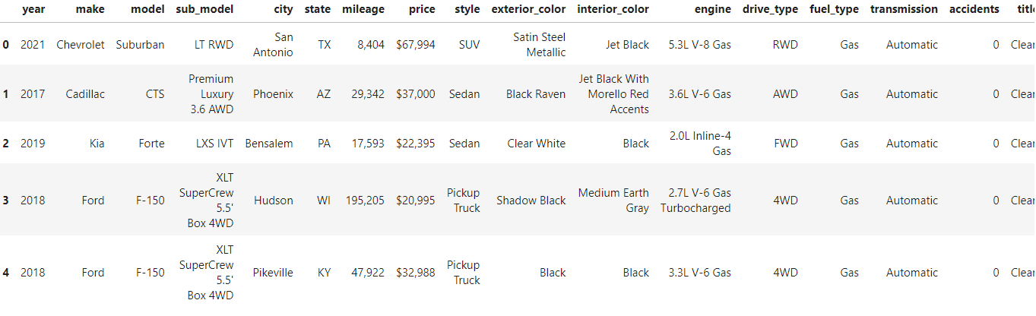
Data
Scraped Car data from online Car Resource website True Cars
Main columns are: [year, mileage, price, model, make]

Slide 6
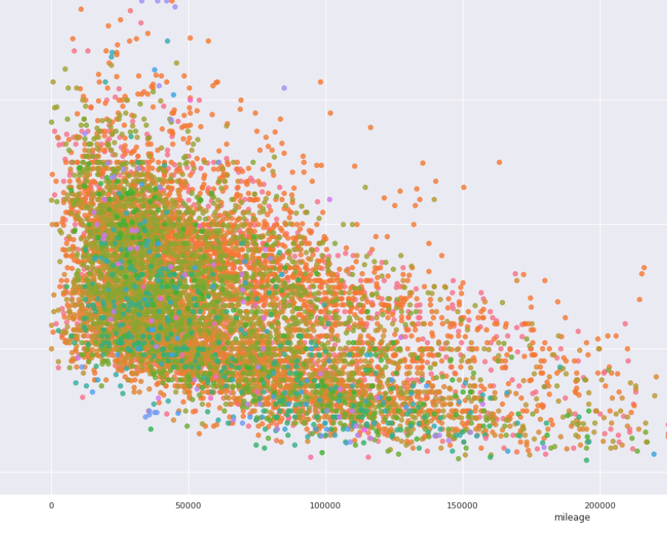
Methods
Preprocessing & Visualization
Feature Importance using Gini Score
KMeans Clustering
Finding the Golden Cluster
Regression Models:
Random Forest Regression

Slide 7
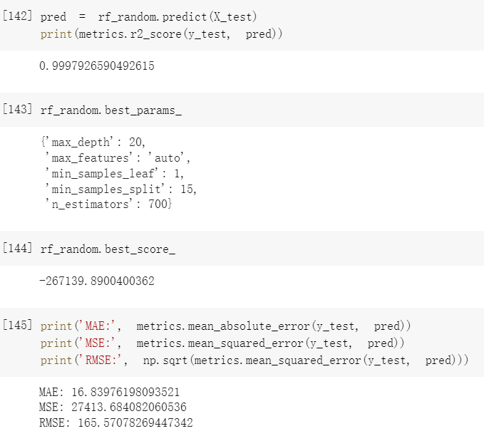
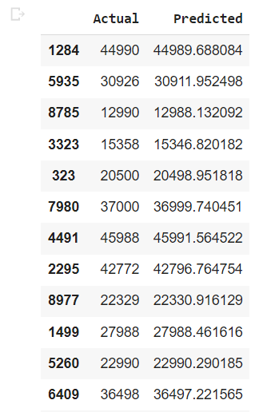
Experiments and Results

Slide 8
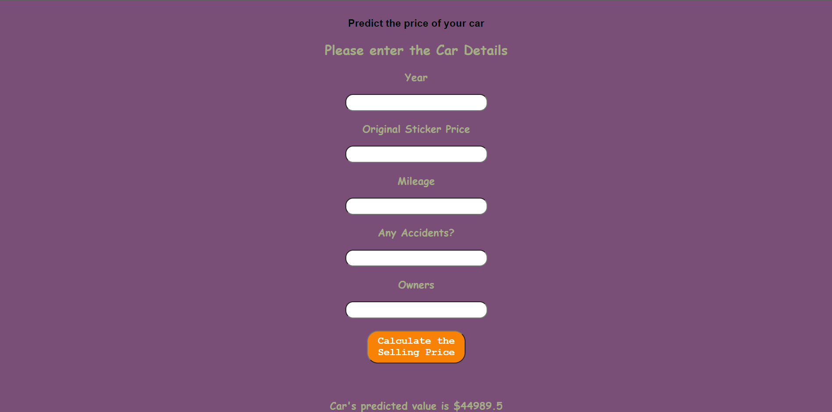
Deployment

